Slide 1
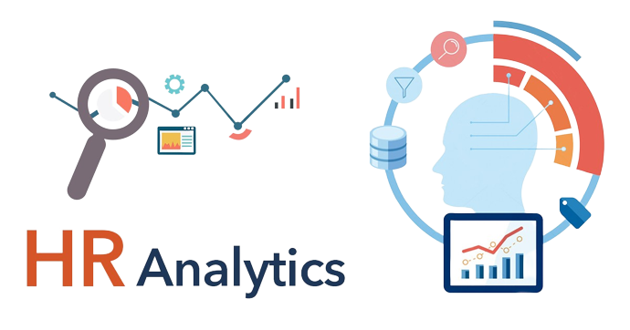
EMPLOYEE RETENTION

Slide 2

Project Name: HR Analytics – Employee Retention
Mentor : Dipti Sinha
Project Members :
Abinaya K R
Aniruddha Naphad
Darshan V M
Kamble Kiran
Shashank K S
Abhijeet N Patil
Manish Ashok Patil

Slide 3
AGENDA :
Introduction & Problem Statement
Business Objective
KPIs
Dashboard
Conclusion

Slide 4
INTRODUCTION:
HR analytics is the process of collecting and analyzing Human Resource data in order to improve an organization’s workforce performance. The process can also be referred to as talent analytics, people analytics, or even workforce analytics.
This method of data analysis takes data that is routinely collected by HR and correlates it to HR and organizational objectives. Doing so provides measured evidence of how HR initiatives are contributing to the organization’s goals and strategies.
Problem Statement:
Average attrition rate for all Departments
Average hourly rate of Male Research Scientist
Attrition rate Vs Monthly Income stats
Average working years for each Department
Job role Vs Work life balance
Attrition rate Vs Years Since last promotion

Slide 5
Business Objective :
Employee retention is the organizational goal of keeping productive and talented workers and reducing turnover by fostering a positive work atmosphere to promote engagement, showing appreciation to employees, providing competitive pay and benefits, and encouraging a healthy work-life balance.
Employee retention is simply an organization's ability to keep its employees. It is essentially the opposite of employee turnover, which is when staff members leave for one reason or another. When measured as a percentage, the employee retention rate and employee turnover rate should add up to 100%.
The ultimate goal of people analytics is to provide meaningful insights on various types of people- and HR data, and by providing that information, actively contribute to the business's bottom line

Slide 6
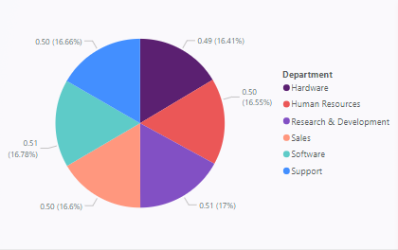
KPI 1 : Average Attrition rate for all Departments
This KPI is to find out the relationship between each department and its attrition rate and here attrition rate is highest for research & Development Department whereas lowest is for Hardware Department.

Slide 7
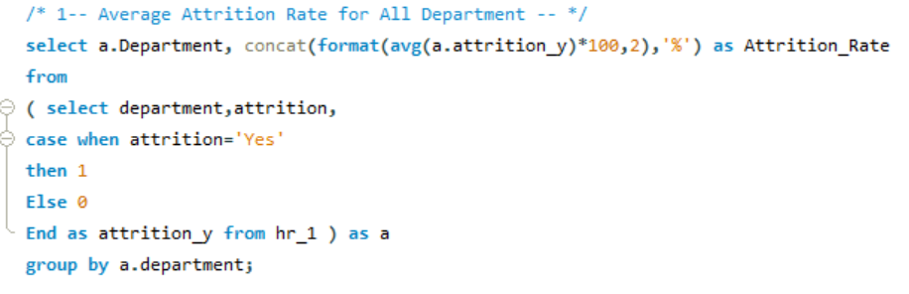
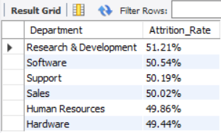
Insights from KPI 1:
Insights from KPI 1:
We can clearly say that attrition rate of employees for every department is almost 50% which indicates that attrition rate of employees does not depends on department. So, irrespective of the department almost 50% of employees are leaving the company.
From this calculation and visualization we concluded that we must make strong strategies to minimize attrition rate and improve our company’s Employee retention so that we can balance the company’s growth and right talent.

Slide 8
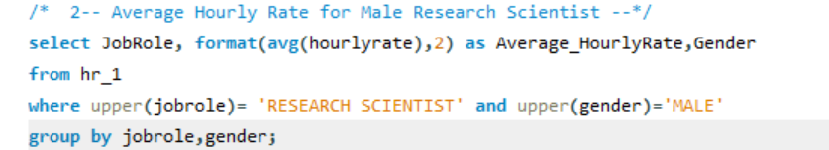
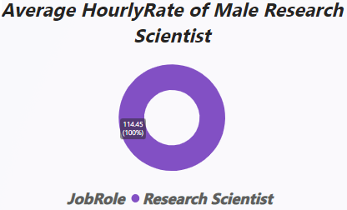
KPI 2 : Average Hourly rate of male Research Scientist
This KPI is to find out the average hourly rate of male research scientists which is 114.45.

Slide 9
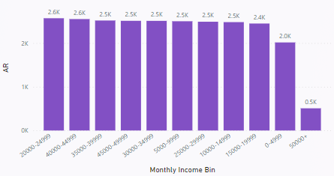
KPI 3 : Attrition Rate vs Monthly Income stats
This KPI is to find out therelation between monthly income attrition

Slide 10
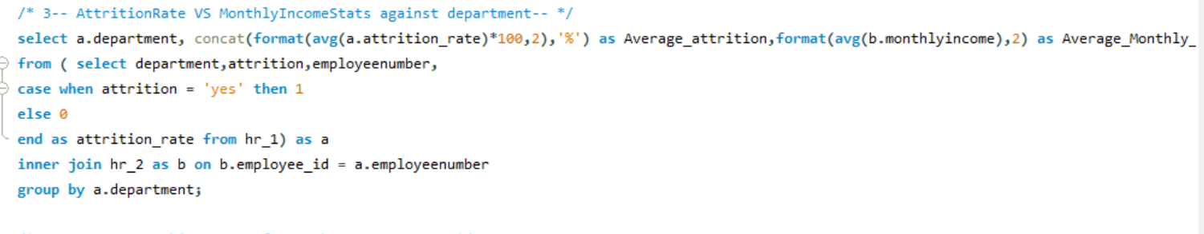
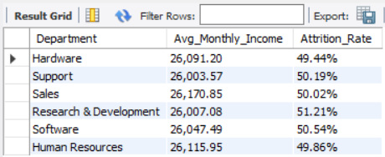
Insights from KPI 3:
Based on our analysis and visualization, it is evident that the Hardware Department has the lowest attrition rate of 49.44%, with an average monthly income of Rs. 26,091.20. On the other hand, the Research and Development Department has the highest attrition rate of 51.21%, with an average monthly income of Rs. 26,007.08

Slide 11
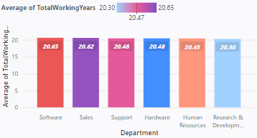
KPI 4 : Average working years for each Department

Slide 12
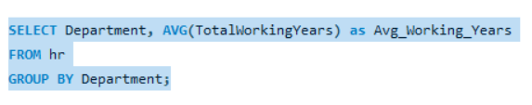
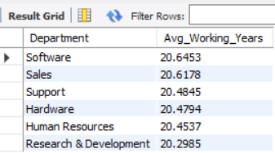
Insights from KPI 4:
From this we can see the average working years in software department is high as compared to the rest of the departments and lowest is for Research & Development Department.
From the analysis we can conclude that average working years is approximately 20 for all the departments.

Slide 13
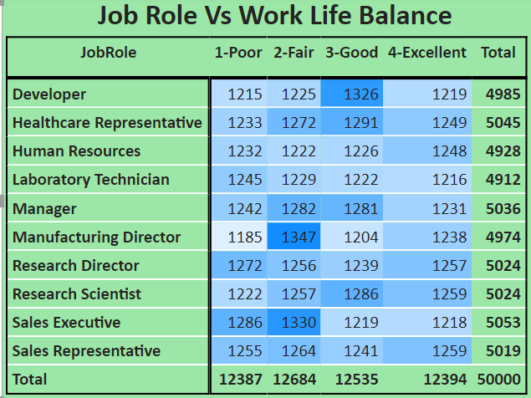
KPI 5 : Job Role vs Work life balance

Slide 14
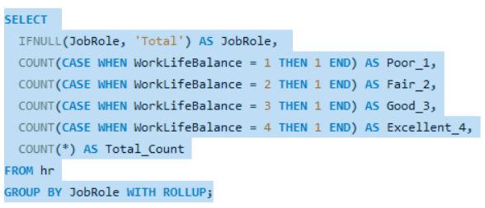
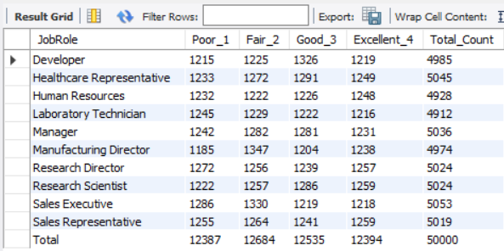
Insights from KPI 5:
From the analysis we can conclude that,
For Research directors and the laboratory technicians the work life balance is poor.
For the Sales representatives , managers , Manufacturing Directors and the Sales executives the work life balance is fair.
For Research Scientists , Healthcare representatives und Developers the work life balance is good.
For human resources the work life balance is excellent.

Slide 15
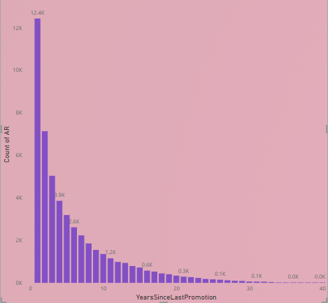
KPI 6 : Attrition rate vs Year since last Promotion relation

Slide 16
Insights from KPI 6:
From the analysis and Visualisation
For 0-5 years since Last year Promotion interval Research & Development and Hardware departments has highest and lowest attrition rate respectively.
For 6-10 years since last year promotion interval Human resources and software departments has highest and lowest attrition rate respectively.
For 11-15 years since last promotion interval support and sales departments has highest and lowest attrition rate respectively.
For 16-20 years since last promotion interval software & hardware departments has highest and lowest attrition respectively.
For 21-25 years since last promotion interval software and support departments has highest and lowest attrition respectively.
For 26-30 years since last promotion interval support and Human resources departments has highest and lowest attrition respectively.
For above 30 years since last promotion interval software and Human resources departments has highest and lowest attrition respectively.

Slide 17
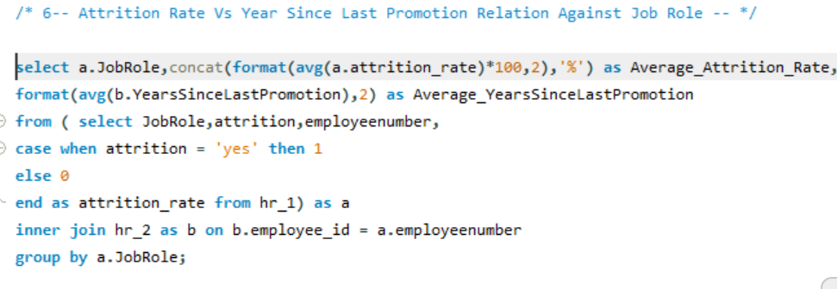
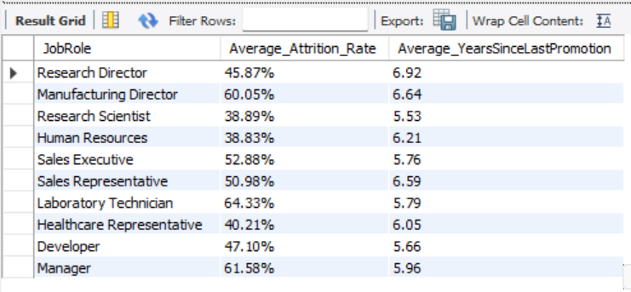

Slide 18
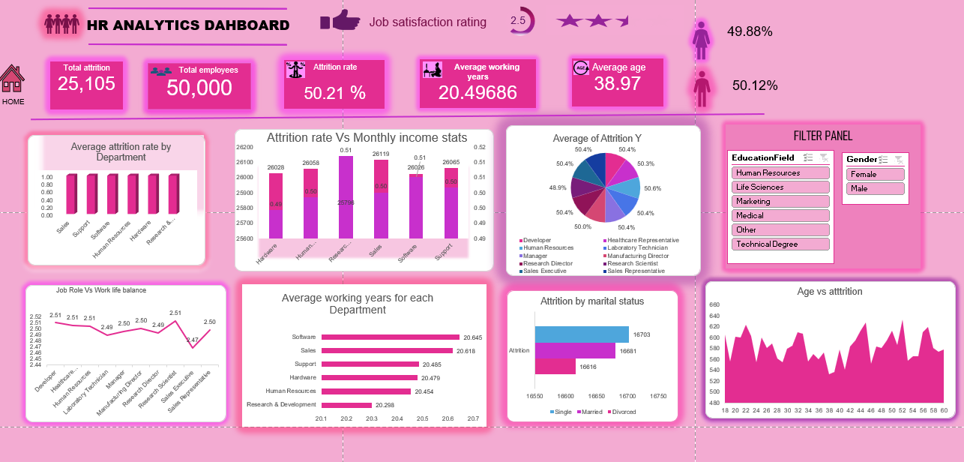

Slide 19
Steps to Reduce Attrition:
Conduct stay interviews: Instead of exit interviews, conduct stay interviews with employees to gather feedback about the job.
Improve employee engagement: Implement initiatives to improve employee engagement, such as regular feedback, recognition and rewards programs, and opportunities for career growth.
Address workload issues: Ensure employees have manageable workloads by regularly monitoring and adjusting workloads to prevent burnout and overwhelm.
Create a positive work environment: Foster a positive work environment by promoting a culture of respect, inclusivity, and teamwork. Encourage open communication and collaboration among employees.
Address pay and compensation issues: Ensure that employees receive fair pay and compensation for their work and to find out what motivates an employee to continue to work in an organization.

Slide 20

Thankyou
Ty Unknown Author is licensed under CC B

